Slide 1
Grafică asistată de calculator
Laborator – Grigore Ionuț

Slide 2
Laboratory 7
CLIP: A Model to Measure the Similarity Between Image and Text

Slide 3
Lab Overview
01
Dataset preparation
02
Text Encoder
Load Flickr 8k, tokenize captions with DistilBERT, apply image transforms, build train/val dataloaders.
Use pretrained DistilBERT to convert any caption into a 768-dimensional vector.
03
Image Encoder
04
Projection Head & CLIP Model
Use pretrained ResNet50 to convert any 224×224 image into a 2048-dimensional vector.
Project both encoders to 256-dim. Train with contrastive loss to align matching pairs.
05
Image retrieval (our CLIP)
06
OpenAI CLIP
Use the trained CLIP to find the best-matching image for a text prompt from the validation set.
Use OpenAI's pretrained ViT-B/32 CLIP to search all 8091 Flickr images — faster and more accurate.

Slide 4
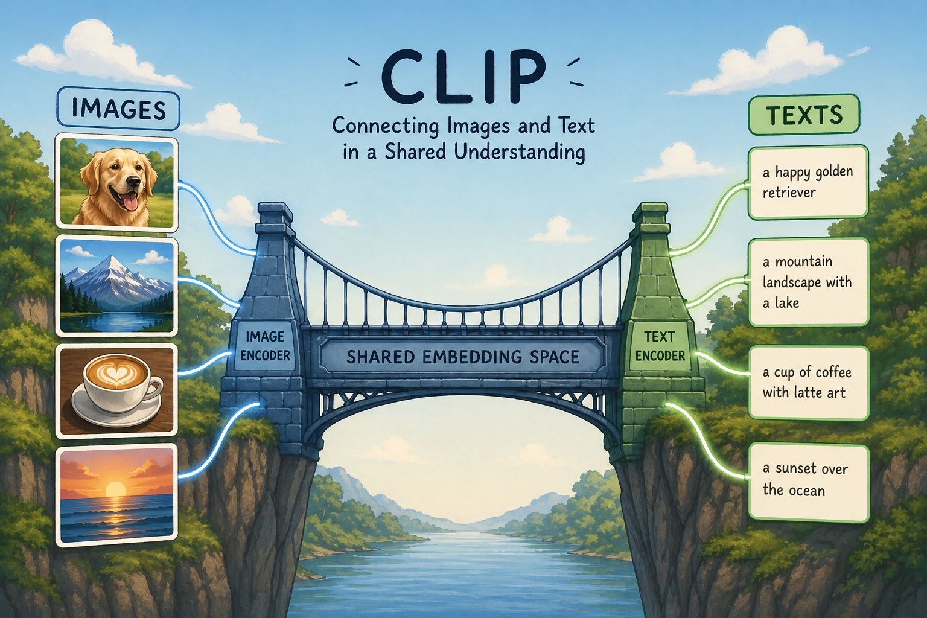
Context — The Bridge Between Images and Text

Slide 5

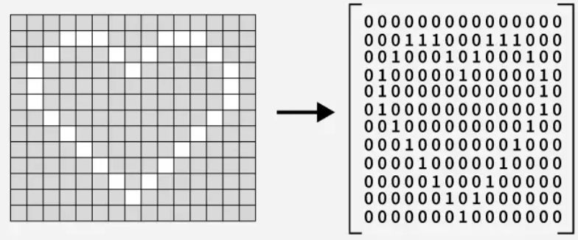
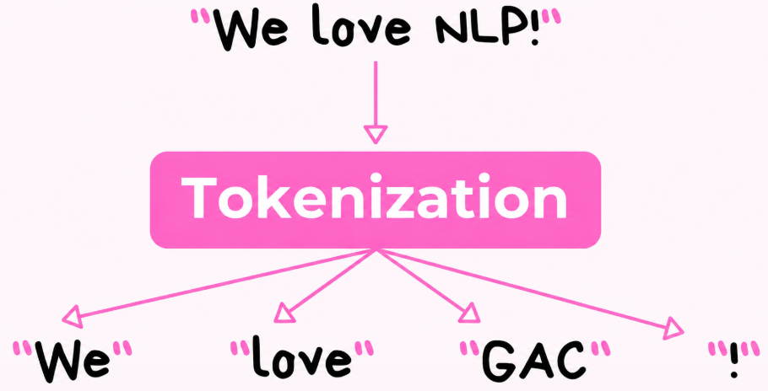

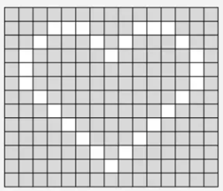
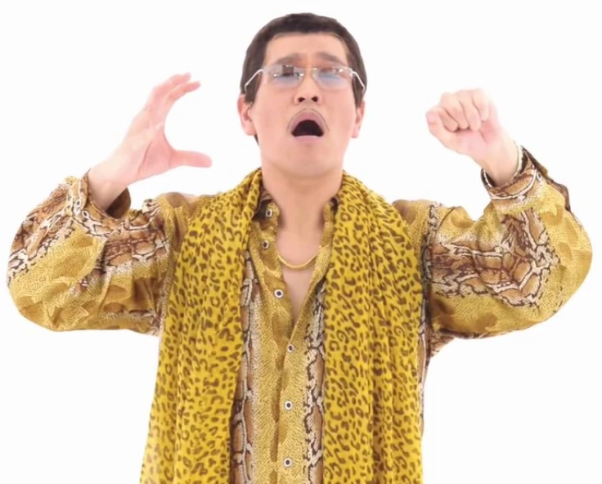
Context — The Bridge Between Images and Text
CLIP = Contrastive Language-Image Pretraining
It answers one question: does this image match this text?
The problem
▸ Images are grids of pixels — numbers with no inherent meaning.
▸ Captions are sequences of words — a completely different format.
▸ How can a model know that an image of a heart matches the text 'We love GAC!' ?

Slide 6
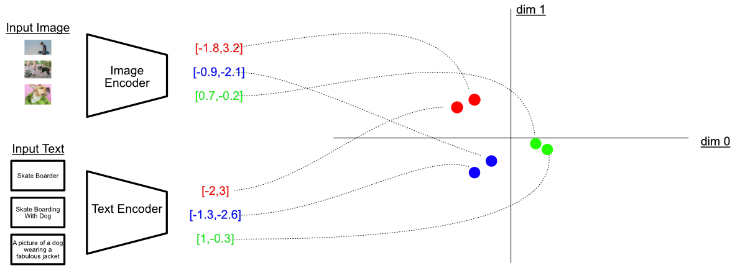
Context — The Bridge Between Images and Text
CLIP = Contrastive Language-Image Pretraining
It answers one question: does this image match this text?
The solution
▸ Project both images and text into the same mathematical space. Then train the model so that matching pairs (image + its caption) land close together and non-matching pairs (image + a different caption) are pushed far apart.
NOTE: 2D view only — real CLIP embeddings are usually 512D

Slide 7
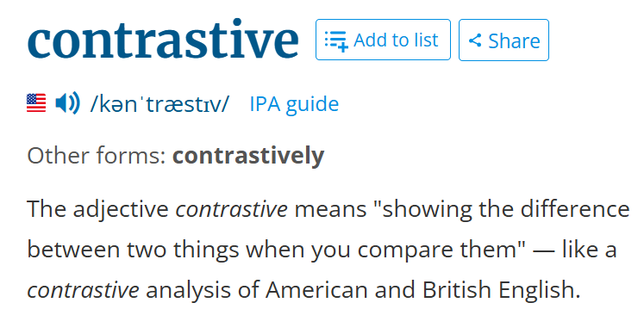
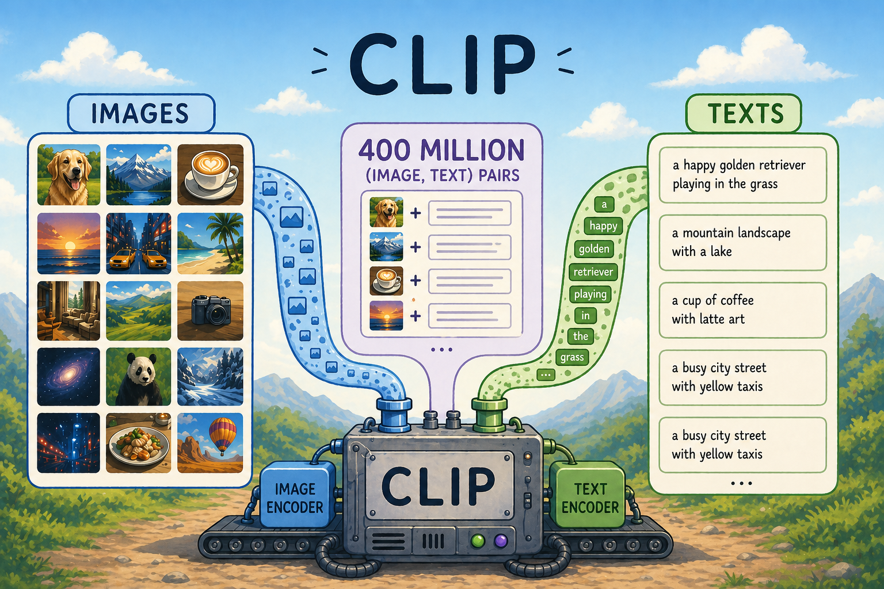



Context — The Bridge Between Images and Text
CLIP = Contrastive Language-Image Pretraining
▸ Contrastive:
▸ Language-Image:
▸ Pretraining
already trained by (pretrained = already trained ☺)

Slide 8
Section 1
Dataset
Preparation

Slide 9
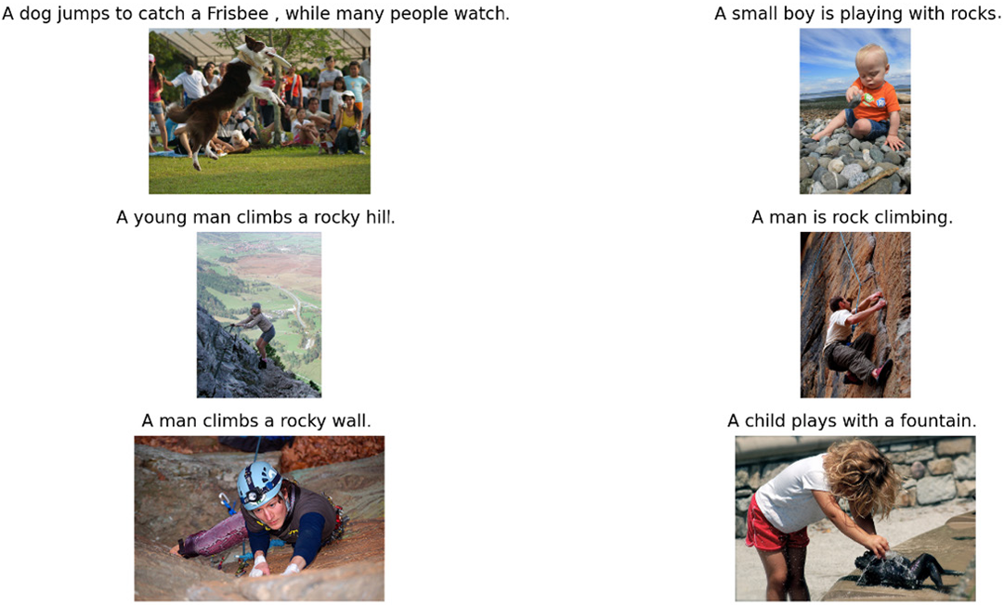
The Flickr 8k Dataset
8 091 photographs from Flickr, each with 5 human-written captions — ideal for training a CLIP model.
8091
40 455
5
Total images
Total captions
Captions per image
NOTE: we select the shortest caption out of the 5 for each image

Slide 10
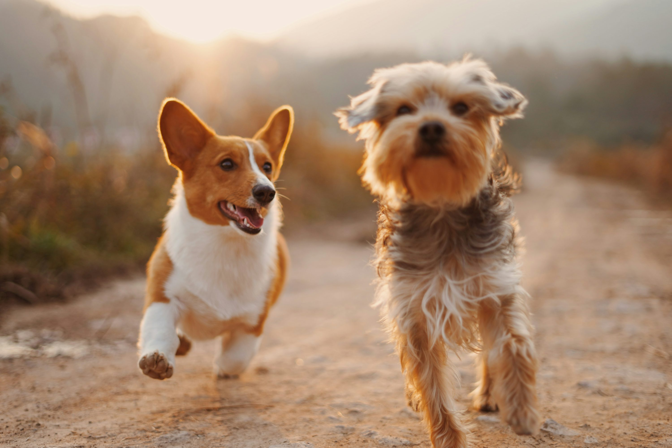
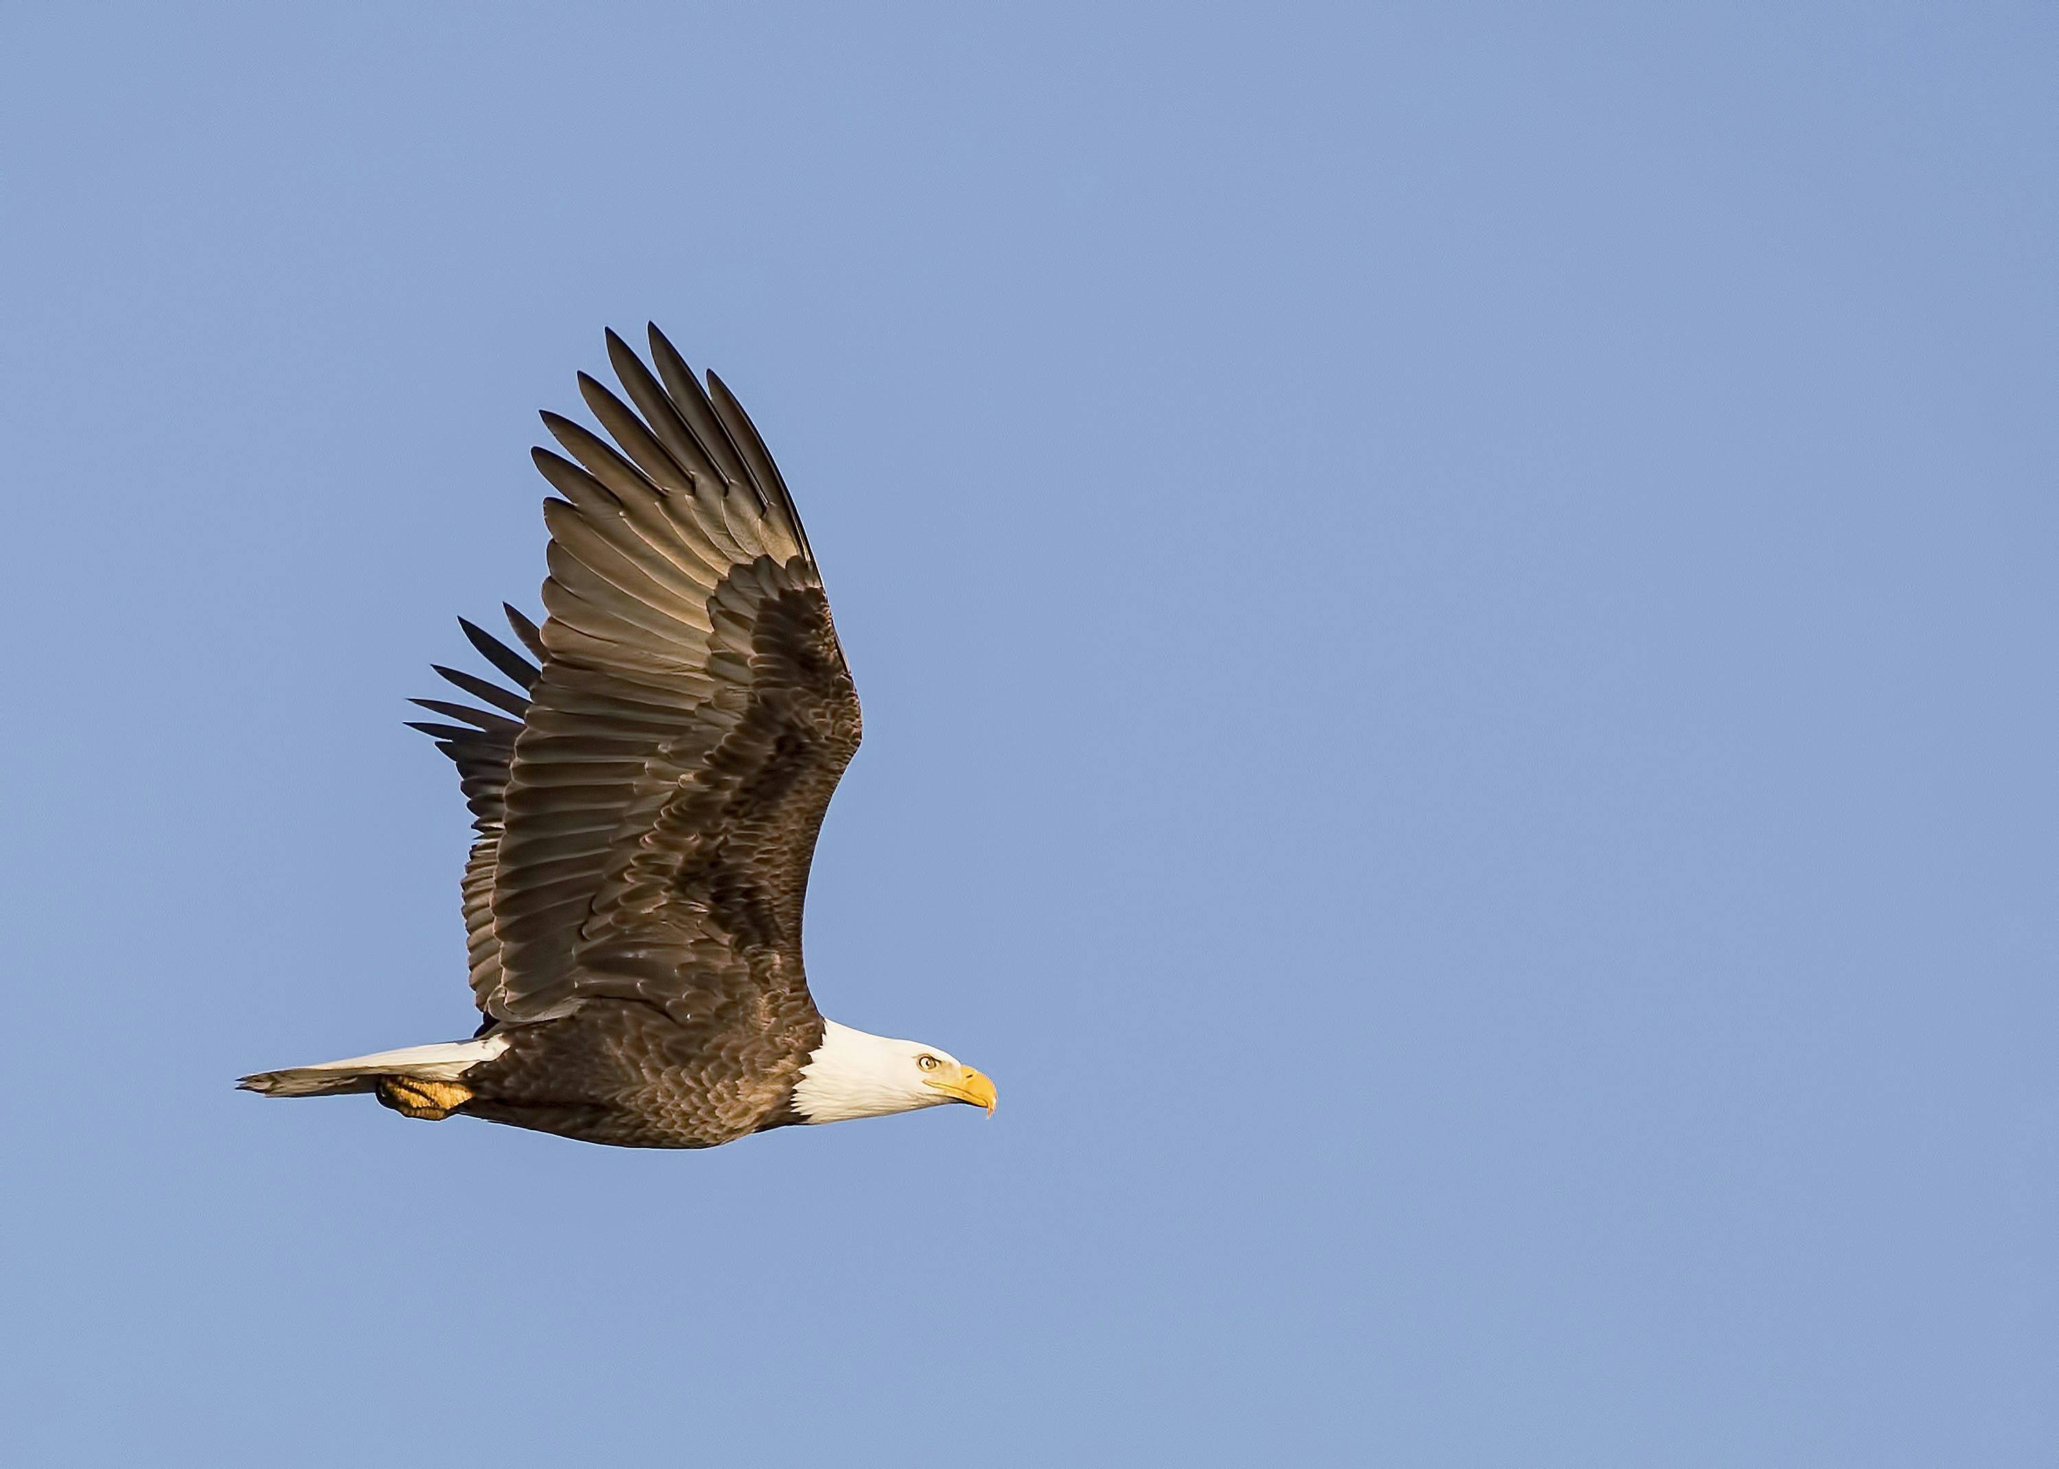
Dataset processing
Caption
"two dogs run"
Tokens
[CLS] two dogs run [SEP] [PAD] [PAD] [PAD]
input_ids
101 1160 6077 2448 102 0 0 0
attention_mask
1 1 1 1 1 0 0 0 (0 = ignore padding)
resized to 224x224
Caption
"an eagle flies in the sky"
Tokens
[CLS] an eagle flies in the sky [SEP]
input_ids
101 2019 8928 8459 1999 1996 3712 102
attention_mask
1 1 1 1 1 1 1 1 (no padding needed)
resized to 224x224
[CLS] = start of sentence marker. [SEP] = end of sentence. [PAD] = padding to equalise batch lengths.
The shorter caption gets padded; the attention_mask tells the model to ignore those zeros.

Slide 11
Section 2
Building the
CLIP Model

Slide 12

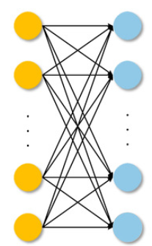
Text Encoder: Pretrained DistilBERT
Converts any caption of any length into a single fixed-size 768-dimensional vector.
"two dogs run"
[CLS] two dogs run [SEP] [PAD] [PAD] [PAD]
101 1160 6077 2448 102 0 0 0
1 1 1 1 1 0 0 0 (0 = ignore padding)
Pretrained DistilBERT Model
- a 66M parameters model developed by
- vector with 768 elements
NOTE: Only this will be trained in order to reduce training time!
- ProjectionHead consisting of linear layers
- vector with 256 elements

Slide 13

Image Encoder: Pretrained ResNet50
Converts any 224×224 color image into a 2048-dimensional feature vector.
resized to 224x224
Pretrained ResNet50 Model
- a 23M parameters model developed by
- vector with 2048 elements
NOTE: Only this will be trained in order to reduce training time!
- ProjectionHead consisting of linear layers
- vector with 256 elements

Slide 14
Section 3
Training &
Image Retrieval

Slide 15
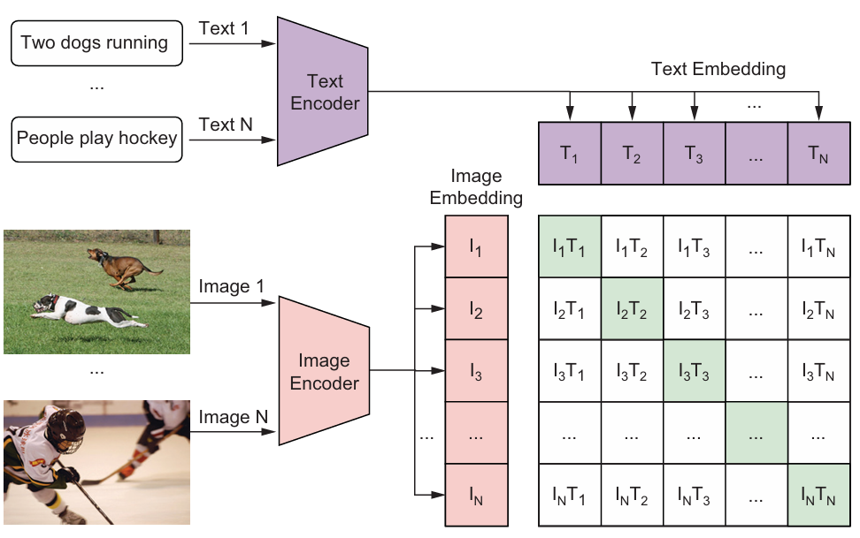
Training the CLIP Model
Similarity matrix (N×N)
For a batch of N pairs, compute text_emb @ image_emb.T → a N×N matrix. Entry (i,j) = similarity between caption i and image j.
Diagonal = correct pairs
The N diagonal entries (i, i) are the matching pairs.
The loss pushes these values to be HIGH (texts close to their own images).
Off-diagonal = wrong pairs
The N×N − N = N(N-1) off-diagonal entries are mismatches.
The loss pushes these values to be LOW (texts far from other images).

Slide 16
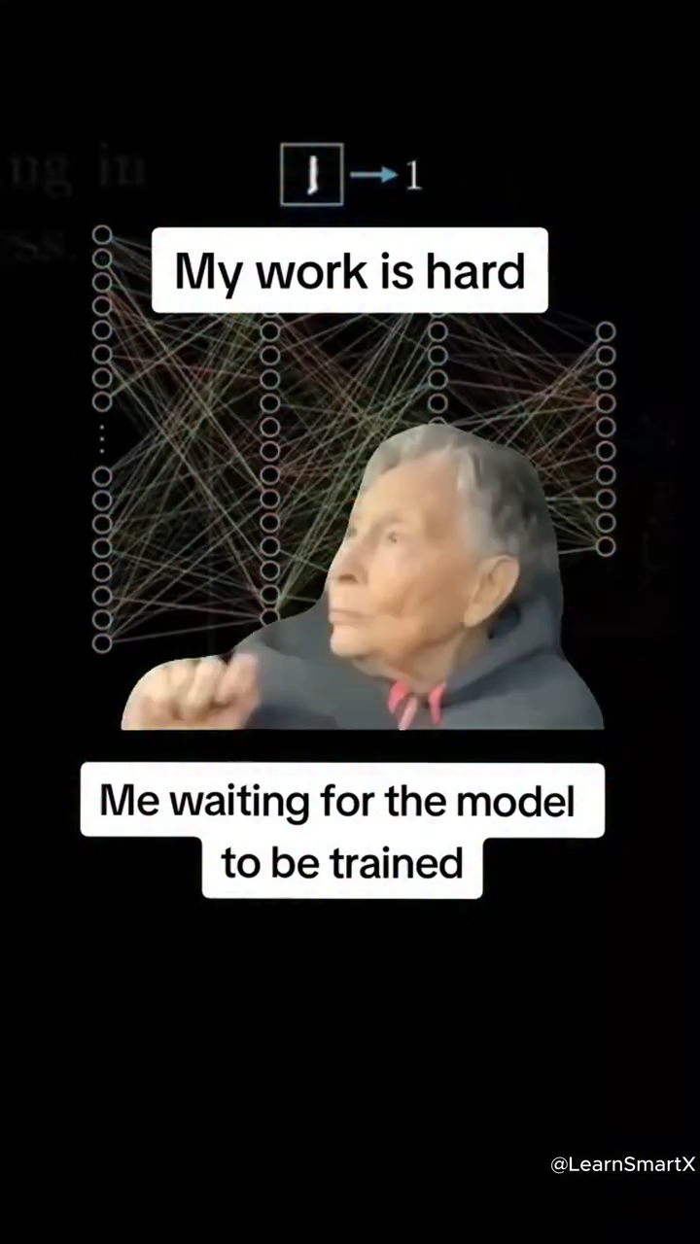
Training the CLIP Model
scaler = torch.amp.GradScaler("cuda")
best_loss = float('inf’)
for epoch in range(10):
print(f"Epoch: {epoch + 1}")
model.train()
losses = []
tqdm_object = tqdm(trainloader, total=len(trainloader))
for batch in tqdm_object: # Iterates through all batches in the training set
batch = {k: v.to(CFG.device) for k, v in batch.items() if k != "caption"}
with torch.amp.autocast("cuda"):
loss = model(batch) # Calculates the loss in the batch
optimizer.zero_grad()
scaler.scale(loss).backward()
scaler.step(optimizer)
scaler.update() # Adjusts model parameters to minimize the loss
losses.append(loss.item())
avgloss=sum(losses)/len(losses)
tqdm_object.set_description(f"loss is {avgloss:.5f}")
evaluate() # Evaluates the current model and saves model parameters if it
# achieves the best performance so far
lr_scheduler.step(avgloss)

Slide 17
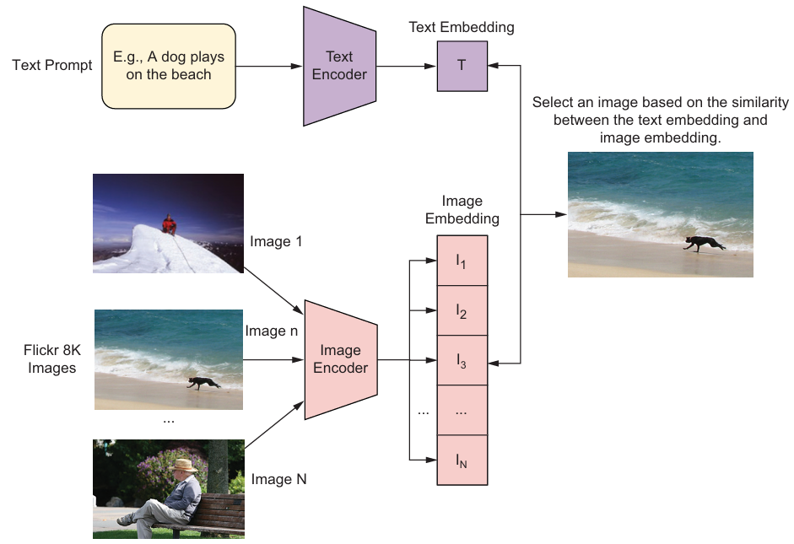
Image Retrieval: How match() Function Works
Given any text prompt → find the image whose embedding is most similar.

Slide 18
Image Retrieval: How match() Function Works
Given any text prompt → find the image whose embedding is most similar.
1
Tokenise the prompt
The text prompt (e.g. 'A dog plays on the beach') is fed to the DistilBERT tokenizer → input_ids + attention_mask.
2
Encode → 768-dim vector
The text encoder (pretrained DistilBERT) converts the token sequence into a 768-dim embedding.
3
Project → 256-dim vector
The projection head maps 768 → 256. This is the text_embedding used for matching.
4
Dot product similarity
text_embedding @ image_embeddings.T computes the dot product of the text with every pre-computed image embedding.
Result: a 1×N score vector, where N is the number of images.
5
Top k scores
The image with the highest score is selected. Its filename and original caption are returned alongside the displayed image.

Slide 19
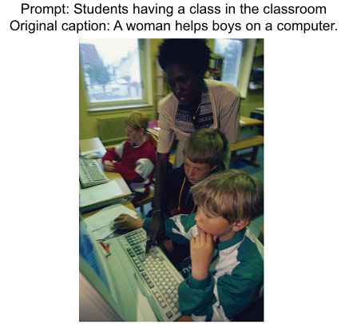
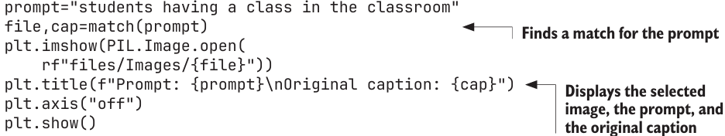
Image Retrieval: How match() Function Works
Given any text prompt → find the image whose embedding is most similar.
def match(prompt):
encoded = tokenizer([prompt]) # Tokenizes the prompt
batch = {key: torch.tensor(values).to(CFG.device) for key, values in encoded.items()}
with torch.no_grad():
text_features = model.text_encoder(input_ids=batch["input_ids"], attention_mask=batch["attention_mask"])
text_embeddings = model.text_projection(text_features) # Creates a text embedding
dot_similarity = text_embeddings @ image_embeddings.T
values, idx = torch.topk(dot_similarity.squeeze(0), 1) # Selects the image with the highest value of similarity with the text prompt
img=valid['image'].values[idx.item()]
caption=valid['caption'].values[idx.item()]
return img, caption

Slide 20
Section 4
OpenAI CLIP:
Pretrained ViT-B/32

Slide 21
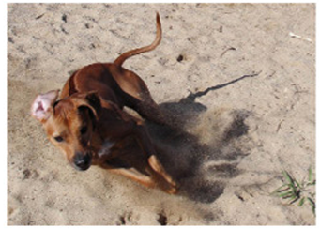
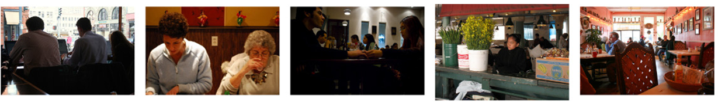
OpenAI Pretrained CLIP (ViT-B/32)
Trained on 400 million image-text pairs — far more powerful than our Flickr-trained model.
Our CLIP vs OpenAI CLIP
Property
Our CLIP (Lab)
OpenAI CLIP
Training data
Flickr 8k (8091 images)
400 million web image-text pairs
Image encoder
ResNet50 (frozen)
ViT-B/32 Vision Transformer
Text encoder
DistilBERT (frozen)
GPT-style transformer (custom)
Embedding dim
256
512
Training time
~4 hours on GPU
Weeks on 256 GPUs (OpenAI scale)
match()/find_match result
Returns top-1 image
Returns top-5 images
prompt: “dog standing in the sand”
prompt: “people eating at the restaurant”

Slide 22
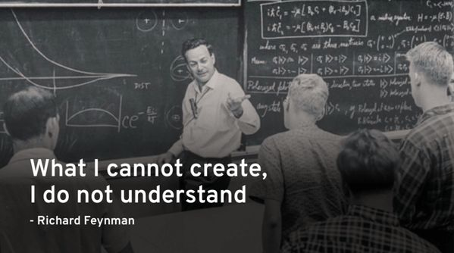

Slide 23
Lab Exercises
01
match() — 'dogs walk on the beach'
Use the match() function to retrieve the best-matching image from the Flickr 8k validation set for the prompt 'dogs walk on the beach'. Plot the selected image and display both the text prompt and the original caption above it.
Hint: call match('dogs walk on the beach'). The function returns (filename, caption).
Use plt.imshow(PIL.Image.open(f'files/Images/{file}')) and set plt.title() with both strings.
02
find_match() — 'people shopping on the street'
Use the OpenAI find_match() function to retrieve the top 5 best-matching images for the prompt 'people shopping on the street'. Plot them in a 1×5 grid (leftmost = most similar).
Hint: call find_match('people shopping on the street'). The function handles all tokenisation and display internally. Make sure image_features is loaded from files/imgfeas.p before calling.

Slide 24
Ex 1
match() — 'dogs walk on the beach'
❓ Use the match() function to retrieve the best-matching image from the Flickr 8k validation set for the prompt 'dogs walk on the beach’.
Plot the selected image and display both the text prompt and the original caption above it.
# Load trained model weights
model = CLIPModel().to(CFG.device) # Instantiates the CLIPModel to create our CLIP model
model.load_state_dict(torch.load("files/best.pth", map_location=CFG.device))
model.eval()
# Compute image embeddings for the validation set
image_embeds = []
with torch.no_grad():
for batch in tqdm(valloader):
image_features = model.image_encoder(batch["image"].to(CFG.device))
image_embeds.append(model.image_projection(image_features))
image_embeddings = torch.cat(image_embeds)
# Copy the match() function from the lab
def match(prompt):
...
prompt = "dogs walk on the beach“
file, cap = match(prompt) # Finds a match for the prompt
plt.imshow(PIL.Image.open(rf"files/Images/{file}"))
plt.title(f"Prompt: {prompt}\nOriginal caption: {cap}") # Displays the selected image, the prompt, and the original caption
plt.axis("off")
plt.show()

Slide 25
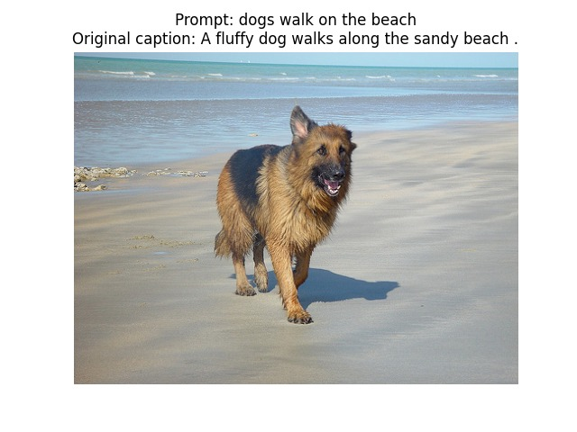
Ex 1
match() — 'dogs walk on the beach'
❓ Use the match() function to retrieve the best-matching image from the Flickr 8k validation set for the prompt 'dogs walk on the beach’.
Plot the selected image and display both the text prompt and the original caption above it.

Slide 26
Ex 2
find_match() — 'people shopping on the street'
❓Use the OpenAI find_match() function to retrieve the top 5 best-matching images for the prompt 'people shopping on the street’.
Plot them in a 1×5 grid (leftmost = most similar).
# Setup: load OpenAI CLIP model
device = "cuda" if torch.cuda.is_available() else "cpu"
clip_model, preprocess = clip.load("ViT-B/32", device=device)
clip_model.eval()
# Compute image embeddings for all images in Flickr 8k
images=[]
for i in names:
images.append(preprocess(Image.open(f"{folder}/{i}")).unsqueeze(0).to(device))
image=torch.cat(images)
with torch.no_grad():
image_features = model.encode_image(image)
# Copy the find_match() function from the lab
def find_match(prompt):
...
prompt = "people shopping on the street"
find_match(prompt)

Slide 27
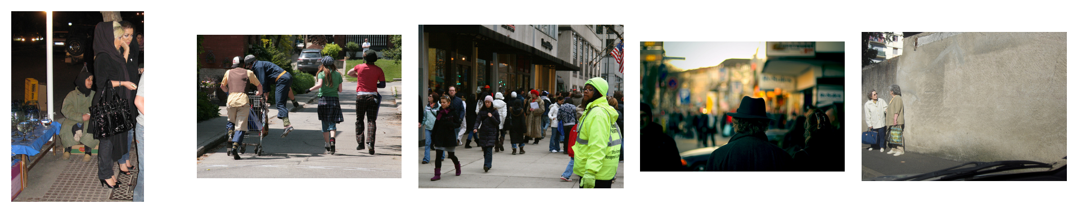
Ex 2
find_match() — 'people shopping on the street'
❓Use the OpenAI find_match() function to retrieve the top 5 best-matching images for the prompt 'people shopping on the street’.
Plot them in a 1×5 grid (leftmost = most similar).

Slide 28
Thank you !

